Slide 1
Looking to the future
Digital Towers
Tim Boyle
General Manager Air Traffic Services

Slide 2
ATC TOWER OF TODAY
Built in the 1960s
Coming to end of life
Replacement cost around $7m

Slide 3
ATC TOWER OF THE FUTURE
Replacement of traditional bricks and mortar with flexible, digital services

Slide 4
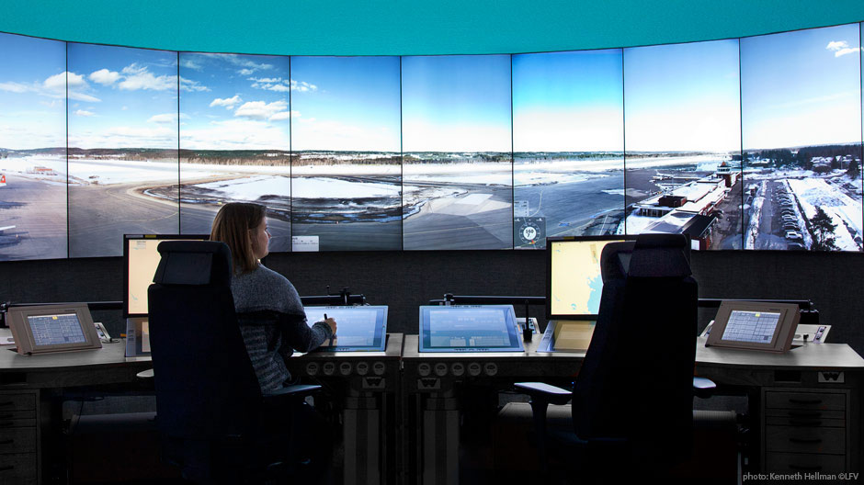

Slide 5
Advantages for Operators
Automatic detection of objects that may pose a threat to flight safety, for example drones and large birds
Airport overlays provide controllers with a clear view of out of bounds areas
Runway incursions can be automatically detected through enhanced tools
Greater visibility through Infrared cameras will allow increased throughput in low visibility conditions
Greater automated decision making of airport movements Contingency system always on
Potential for 100% capacity in movements during contingency operations
Fewer disruptions to flights in a contingency operation
Cheaper/more flexible services

Slide 7
Challenges for Controllers
Automation does lead to complacency – we know this from other systems
The overlaid information now becomes the “new normal” and basic skills are lost
The challenge is to keep the skill set the same as today – and use it as though you used it everyday
The bottom line is the technology is easy – the People part and change management are the tricky bits!

